Slide 1


Introduction to Operating Systems
ILIA STATE UNIVERSITY
Paata Gogishvili
Doctor of Informatics
Associate Professor
School of Technology
June 10, 2023
Faculty of Business, Technology and Education

Slide 2
Lecture Topic
Firewall
ILIA STATE UNIVERSITY

Slide 3
Introduction
A firewall is a network security device or software that acts as a barrier between an internal network and external networks, such as the internet. It monitors and controls incoming and outgoing network traffic based on predetermined security rules. The primary purpose of a firewall is to protect a network from unauthorized access and potential threats.
ILIA STATE UNIVERSITY

Slide 4
Network Segmentation
Firewalls allow network administrators to divide a network into separate segments or zones, often referred to as security zones. This helps in isolating different parts of the network, allowing granular control over the flow of traffic between them.
ILIA STATE UNIVERSITY

Slide 5
Packet Filtering
Firewalls use packet filtering techniques to inspect individual network packets and make decisions about whether to allow or block them based on predefined rules. These rules typically consider factors such as source and destination IP addresses, port numbers, protocols, and other packet attributes.
ILIA STATE UNIVERSITY

Slide 6
Access Control
Firewalls enforce access control policies to determine which network traffic is allowed to pass through. By defining rules, administrators can specify which services, applications, or ports are permitted or denied, thus restricting access to certain resources and reducing the attack surface.
ILIA STATE UNIVERSITY

Slide 7
Stateful Inspection
Stateful firewalls maintain awareness of the state of network connections. They keep track of the context and state of each connection, allowing them to make more intelligent decisions about allowing or blocking traffic. This helps prevent unauthorized connections and various types of network attacks, including session hijacking and spoofing.
ILIA STATE UNIVERSITY

Slide 8
Application-Level Filtering
Some advanced firewalls perform deep packet inspection, allowing them to inspect the contents of network packets beyond just the packet headers. This enables them to identify and block specific types of application-layer attacks, such as malware, viruses, and certain network protocols that may pose a security risk.
ILIA STATE UNIVERSITY

Slide 9
Virtual Private Network (VPN) Support
Many firewalls include VPN functionality to create secure encrypted tunnels for remote users or branch offices to connect to the internal network securely over the internet. This adds an extra layer of protection, ensuring that sensitive data transmitted over the VPN remains secure and private.
ILIA STATE UNIVERSITY

Slide 10
Logging and Reporting
Firewalls often provide logging and reporting capabilities to help administrators analyze network traffic, identify potential security incidents, and generate reports for compliance or auditing purposes. These logs can be used for troubleshooting, forensic analysis, or monitoring network activity.
ILIA STATE UNIVERSITY

Slide 11
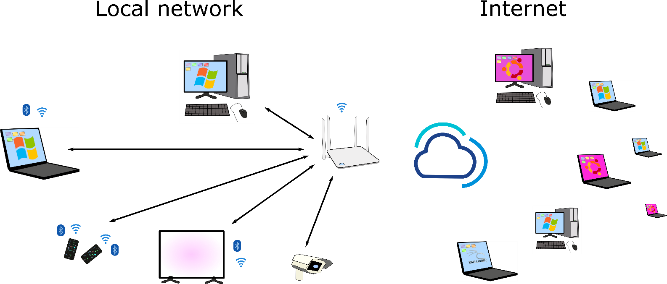
The network
Organizations have the local networks. The local network needs the firewall to be protected from outside attacks.
ILIA STATE UNIVERSITY

Slide 12
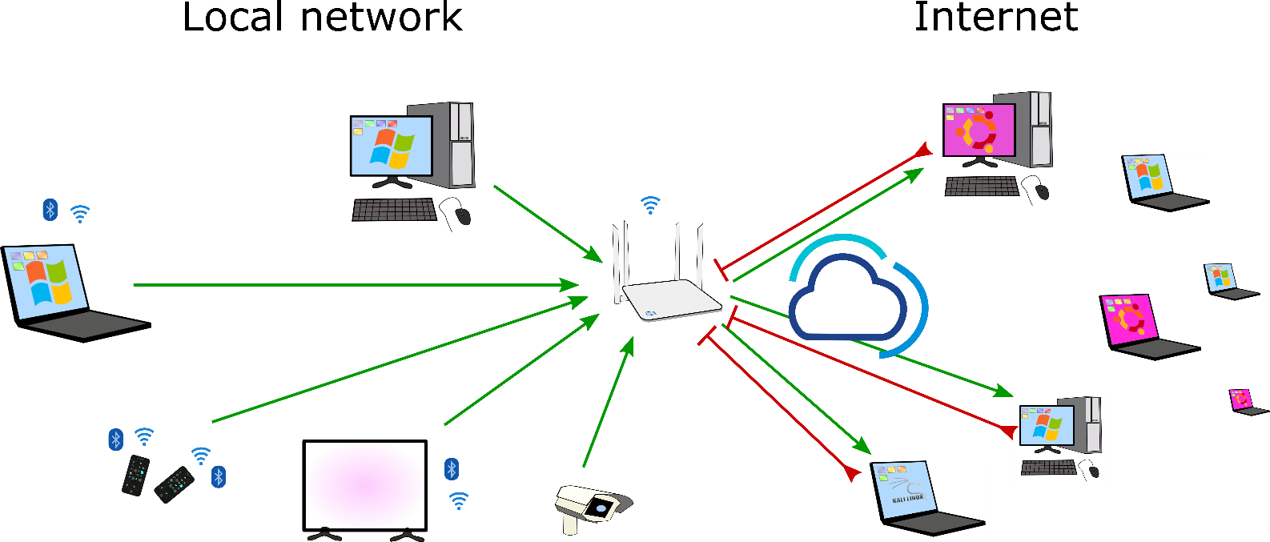
Only outbound traffic allowed
In simple cases only outbound connections are needed for LANs. All inbound traffic should be blocked in this case.
ILIA STATE UNIVERSITY

Slide 13
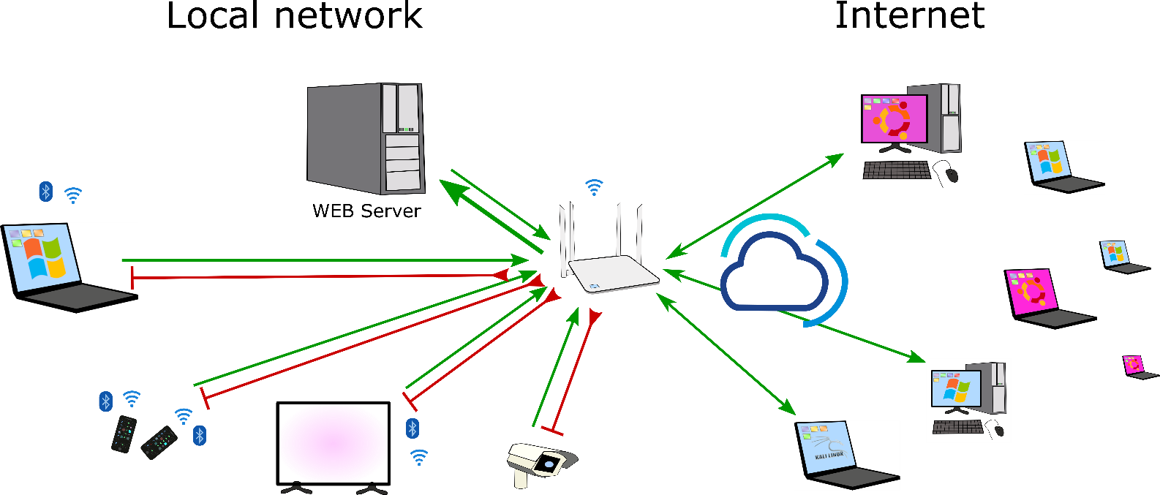
Some inbound connections are allowed
In some cases the organization needs some inbound traffic to be allowed. For example if the organization hosts the web server.
ILIA STATE UNIVERSITY

Slide 14
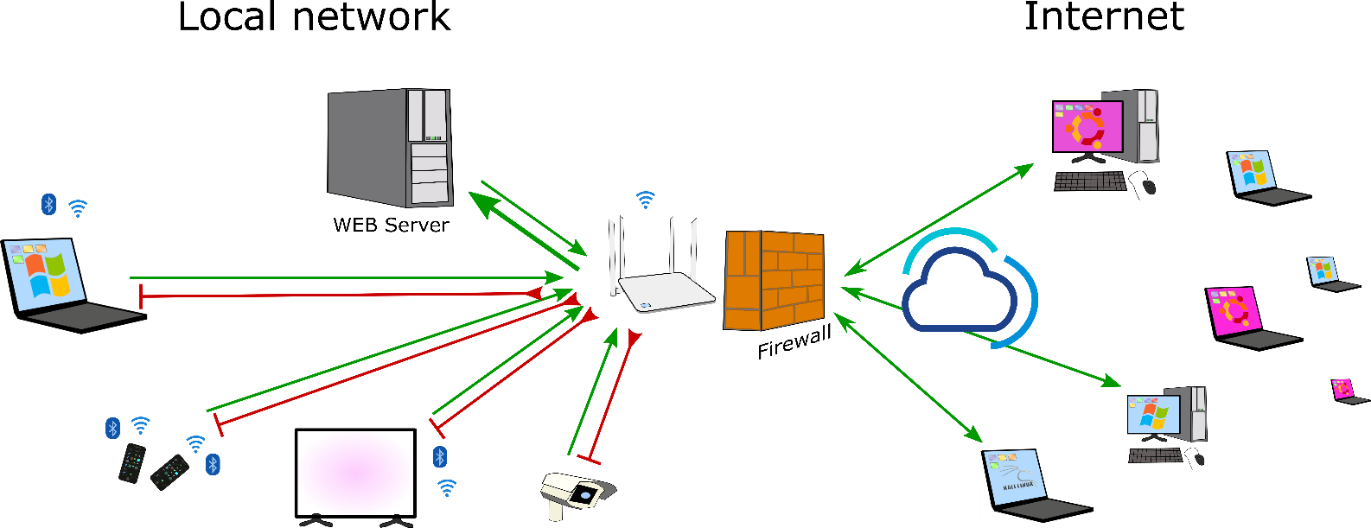
Connections are controlled by the Firewall
Firewall can be standalone device or the part of another device.
ILIA STATE UNIVERSITY

